Slide 1
Word Embeddings
Dr. Alaa Sheta

Slide 2
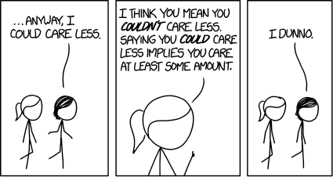
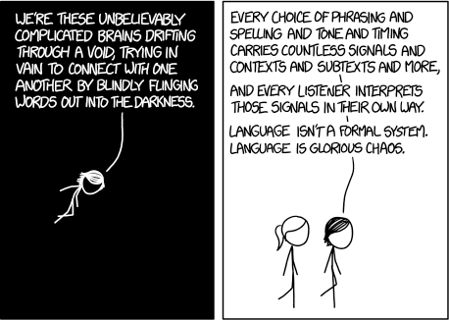
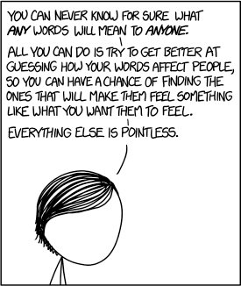
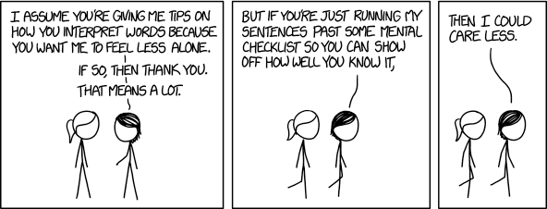
https://xkcd.com/1576/ Randall Munroe CC BY NC 2.5

Slide 3
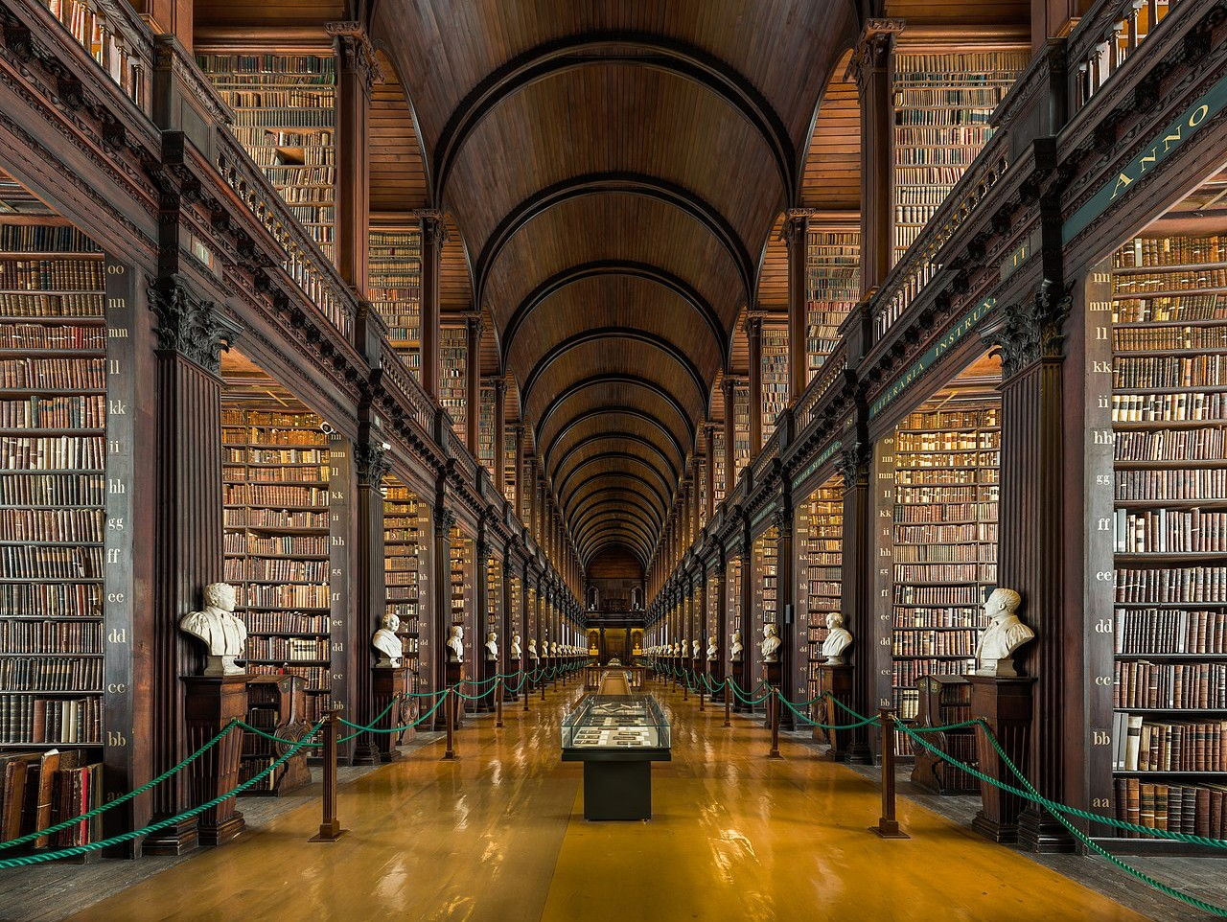

Slide 4
How do we represent the meaning of a word?
Definition: meaning (Webster dictionary)
the idea that is represented by a word, phrase, etc.
the idea that a person wants to express by using words, signs, etc.
the idea that is expressed in a work of writing, art, etc.
Commonest linguistic way of thinking of meaning:
signifier (symbol) ⟺ signified (idea or thing)
= denotational semantics
10

Slide 5

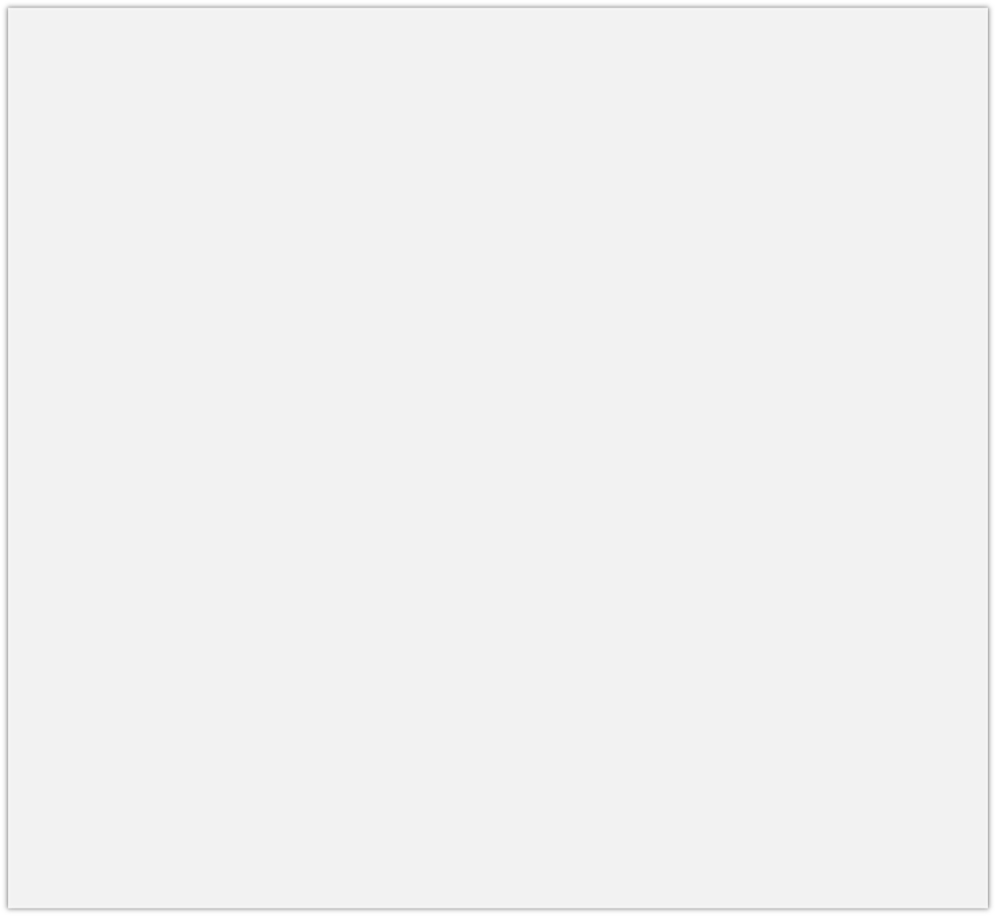
How do we have usable meaning in a computer?
Common solution: Use e.g. WordNet, a thesaurus containing lists of synonym sets and hypernyms (“is a” relationships).
e.g. synonym sets containing “good”: e.g. hypernyms of “panda”:
from nltk.corpus import wordnet as wn
poses = { 'n':'noun', 'v':'verb', 's':'adj (s)', 'a':'adj', 'r':'adv'} for synset in wn.synsets("good"):
print("{}: {}".format(poses[synset.pos()],
", ".join([l.name() for l in synset.lemmas()])))
from nltk.corpus import wordnet as wn panda = wn.synset("panda.n.01")
hyper = lambda s: s.hypernyms()
list(panda.closure(hyper))
noun: good
noun: good, goodness noun: good, goodness
noun: commodity, trade_good, good
adj: good
adj (sat): full, good adj: good
adj (sat): estimable, good, honorable, respectable adj (sat): beneficial, good
adj (sat): good
adj (sat): good, just, upright
…
adverb: well, good
adverb: thoroughly, soundly, good
[Synset('procyonid.n.01'), Synset('carnivore.n.01'), Synset('placental.n.01'), Synset('mammal.n.01'), Synset('vertebrate.n.01'), Synset('chordate.n.01'), Synset('animal.n.01'), Synset('organism.n.01'), Synset('living_thing.n.01'), Synset('whole.n.02'),
Synset('object.n.01'), Synset('physical_entity.n.01'), Synset('entity.n.01')]

Slide 6
Problems with resources like WordNet
Great as a resource but missing nuance
e.g. “proficient” is listed as a synonym for “good”. This is only correct in some contexts.
Missing new meanings of words
e.g., wicked, badass, nifty, wizard, genius, ninja, bombest
Impossible to keep up-to-date!
Subjective
Requires human labor to create and adapt
Can’t compute accurate word similarity →

Slide 7
Representing words as discrete symbols
In traditional NLP, we regard words as discrete symbols: hotel, conference, motel – a localist representation
Means one 1, the rest 0s
Words can be represented by one-hot vectors:
motel = [0 0 0 0 0 0 0 0 0 0 1 0 0 0 0]
hotel = [0 0 0 0 0 0 0 1 0 0 0 0 0 0 0]
Vector dimension = number of words in vocabulary (e.g., 500,000)

Slide 8
Problem with words as discrete symbols
Sec. 9.2.2
Example: in web search, if user searches for “Seattle motel”, we would like to match documents containing “Seattle hotel”.
But:
motel = [0 0 0 0 0 0 0 0 0 0 1 0 0 0 0]
hotel = [0 0 0 0 0 0 0 1 0 0 0 0 0 0 0]
These two vectors are orthogonal.
There is no natural notion of similarity for one-hot vectors!
Solution:
Could try to rely on WordNet’s list of synonyms to get similarity?
But it is well-known to fail badly: incompleteness, etc.
Instead: learn to encode similarity in the vectors themselves

Slide 9
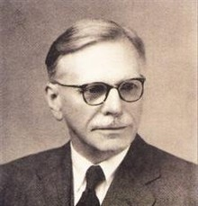
Representing words by their context
Distributional semantics: A word’s meaning is given by the words that frequently appear close-by
“You shall know a word by the company it keeps” (J. R. Firth 1957: 11)
One of the most successful ideas of modern statistical NLP!
When a word w appears in a text, its context is the set of words that appear nearby (within a fixed-size window).
Use the many contexts of w to build up a representation of w
…government debt problems turning into
…saying that Europe needs unified
…India has just given its
banking
banking banking
crises as happened in 2009…
regulation to replace the hodgepodge… system a shot in the arm…
15
These context words will represent banking

Slide 10
Word vectors
We will build a dense vector for each word, chosen so that it is similar to vectors of words that appear in similar contexts
0.286
0.792
−0.177
−0.107
0.109
−0.542
0.349
0.271
banking =
Note: word vectors are sometimes called word embeddings or word representations. They are a distributed representation.

Slide 11
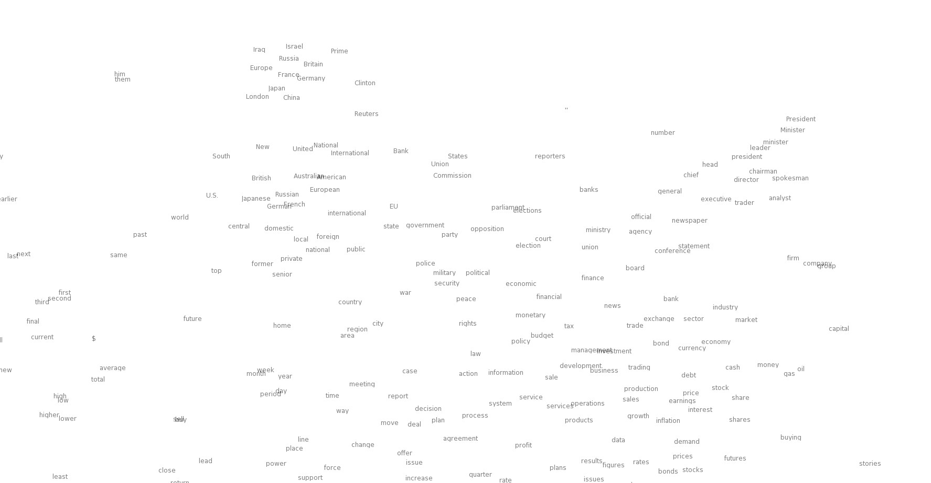

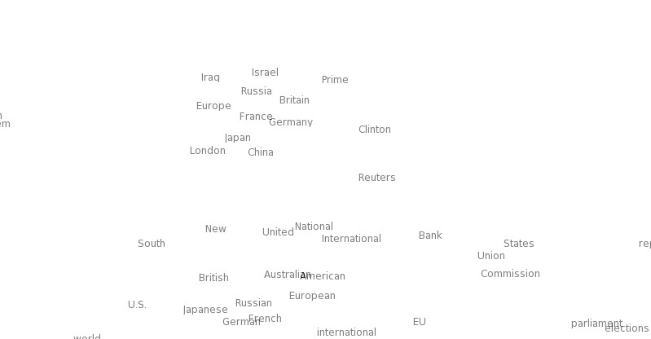
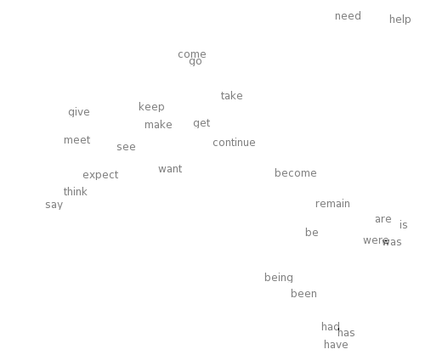
Word meaning as a neural word vector – visualization
0.286
0.792
−0.177
−0.107
0.109
−0.542
0.349
0.271
0.487
expect =

Slide 12
3. Word2vec: Overview
Word2vec (Mikolov et al. 2013) is a framework for learning word vectors
Idea:
We have a large corpus of text
Every word in a fixed vocabulary is represented by a vector
Go through each position t in the text, which has a center word
c and context (“outside”) words o
Use the similarity of the word vectors for c and o to calculate the probability of o given c (or vice versa)
Keep adjusting the word vectors to maximize this probability

Slide 13
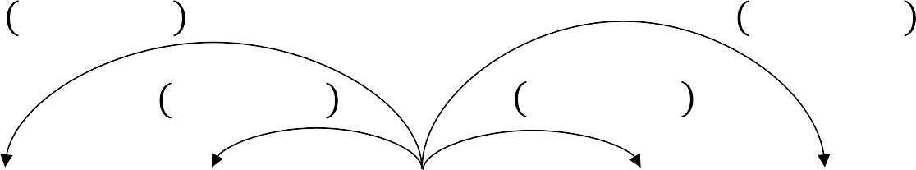
Word2Vec Overview
Example windows and process for computing 𝑃 𝑤_{89:} | 𝑤₈
𝑃 𝑤_{8>=} | 𝑤₈
𝑃 𝑤_{8><} | 𝑤₈
𝑃 𝑤₈₉₌ | 𝑤₈
𝑃 𝑤_{89<} | 𝑤₈
…
problems
turning
into
banking
crises
as
…
outside context words center word outside context words in window of size 2 at position t in window of size 2

Slide 14
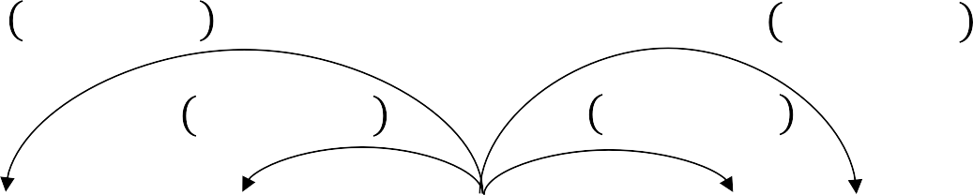
Word2Vec Overview
Example windows and process for computing 𝑃 𝑤_{89:} | 𝑤₈
𝑃 𝑤_{8>=} | 𝑤₈
𝑃 𝑤_{8><} | 𝑤₈
𝑃 𝑤₈₉₌ | 𝑤₈
𝑃 𝑤_{89<} | 𝑤₈
…
problems
turning
into
banking
crises
as
…
outside context words center word outside context words in window of size 2 at position t in window of size 2

Slide 15
Word2vec: objective function
For each position 𝑡 = 1, … , 𝑇, predict context words within a window of fixed size m, given center word 𝑤:.
I
= G G
8H< >JK:KJ
:LM
𝑃 𝑤_{89:} | 𝑤₈; 𝜃
Likelihood = 𝐿 𝜃
𝜃 is all variables to be optimized
sometimes called cost or loss function
The objective function 𝐽 𝜃 is the (average) negative log likelihood:
I
1 1
𝐽 𝜃 = − _{𝑇} log 𝐿(𝜃) = − _{𝑇} S S log 𝑃 𝑤_{89:} | 𝑤₈; 𝜃
8H< >JK:KJ
:LM
Minimizing objective function ⟺ Maximizing predictive accuracy

Slide 16
Word2vec: objective function
We want to minimize the objective function:
1
I
𝐽 𝜃 = − _{𝑇} S S log 𝑃 𝑤_{89:} | 𝑤₈; 𝜃
8H< >JK:KJ
:LM
Question: How to calculate 𝑃 𝑤_{89:} | 𝑤₈; 𝜃 ?
Answer: We will use two vectors per word w:
𝑣_{U} when w is a center word
𝑢_{U} when w is a context word
Then for a center word c and a context word o:
exp(𝑢^{I}𝑣 )
𝑃 𝑜 𝑐 =
Y Z
∑ exp(𝑢^{I} 𝑣 )
22
U∈]
U Z

Slide 17
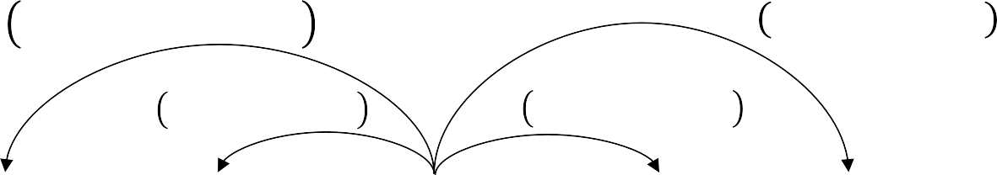
Word2Vec Overview with Vectors
Example windows and process for computing 𝑃 𝑤_{89:} | 𝑤₈
short for P 𝑝𝑟𝑜𝑏𝑙𝑒𝑚𝑠 | 𝑖𝑛𝑡𝑜 ; 𝑢_{^_Y`abJc}, 𝑣_{de8Y}, 𝜃
^{𝑃 𝑢}^_Y`abJc ^{| 𝑣}de8Y
^{𝑃 𝑢}^_Y`abJc ^{| 𝑣}de8Y
^{𝑃 𝑢}8seder ^{| 𝑣}de8Y
^{𝑃 𝑢}Z_dcdc ^{|𝑣}de8Y
^{𝑃 𝑢}`peqder ^{|𝑣}de8Y
…
problems
turning
into
banking
crises
as
…
outside context words center word outside context words in window of size 2 at position t in window of size 2

Slide 18
Word2vec: prediction function
② Exponentiation makes anything positive
① Dot product compares similarity of o and c.
exp(𝑢^{I}𝑣 )
𝑢^{I}𝑣 = 𝑢. 𝑣 = ∑^{e} 𝑢_{d}𝑣_{d}
₌ Y Z
dH<
𝑃 𝑜 𝑐
Larger dot product = larger probability
∑ exp(𝑢^{I} 𝑣 )
U∈]
U Z
③ Normalize over entire vocabulary to give probability distribution
This is an example of the softmax function ℝ^{e} → (0,1)^{e}
exp(𝑥_{d})
Open region
softmax 𝑥_{d} =
∑e
= 𝑝
exp(𝑥:)
d
:H<
The softmax function maps arbitrary values 𝑥_{d} to a probability distribution 𝑝_{d}
“max” because amplifies probability of largest 𝑥_{d}
“soft” because still assigns some probability to smaller 𝑥_{d}
Frequently used in Deep Learning

Slide 19
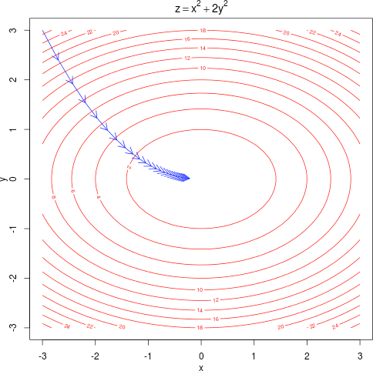
Training a model by optimizing parameters
To train a model, we adjust parameters to minimize a loss E.g., below, for a simple convex function over two parameters Contour lines show levels of objective function

Slide 20
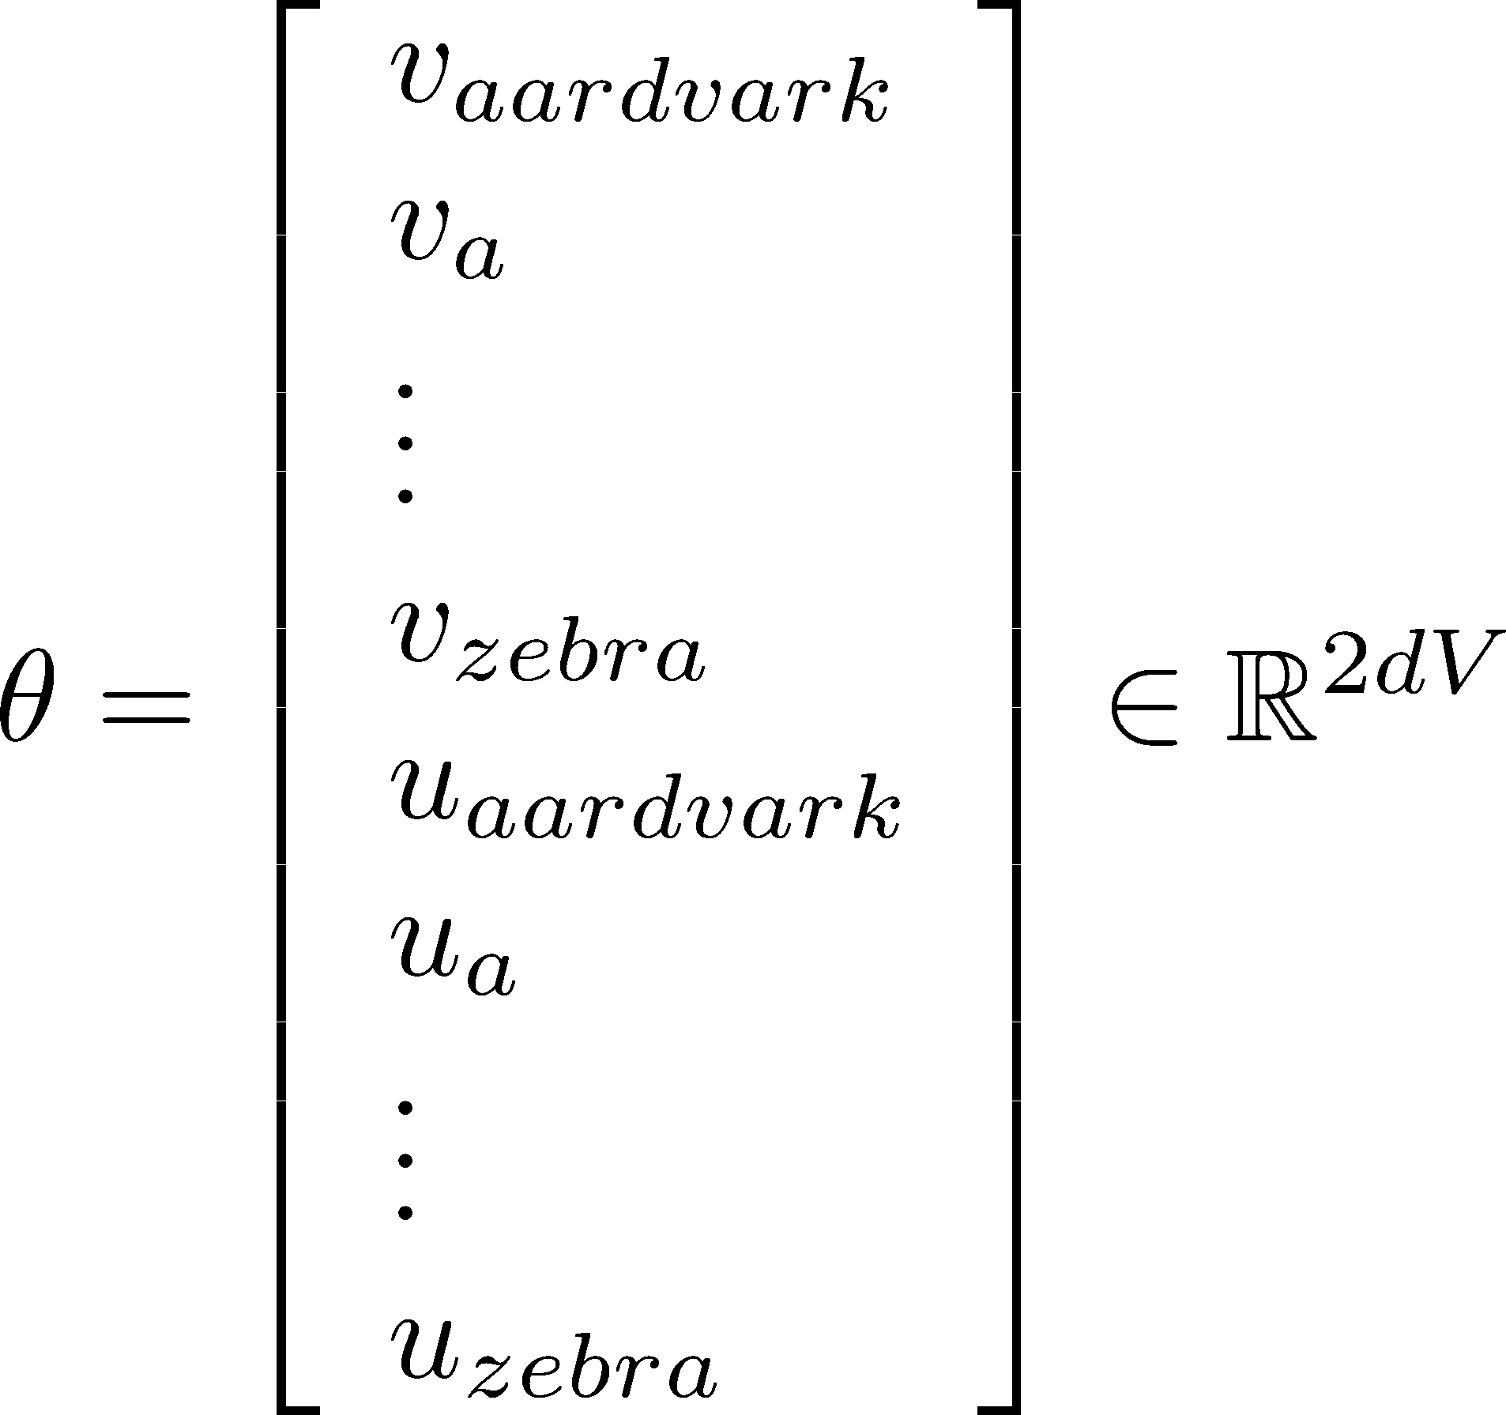
To train the model: Compute all vector gradients!
Recall: 𝜃 represents all model parameters, in one long vector
In our case with d-dimensional vectors and V-many words:
Remember: every word has two vectors
We optimize these parameters by walking down the gradient

Slide 21
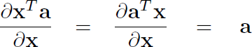
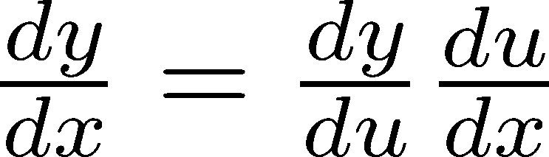
4. Word2vec derivations of gradient
Whiteboard – see video if you’re not in class ;)
The basic Lego piece
Useful basics:
If in doubt: write out with indices
Chain rule! If y = f(u) and u = g(x), i.e. y = f(g(x)), then:

Slide 22
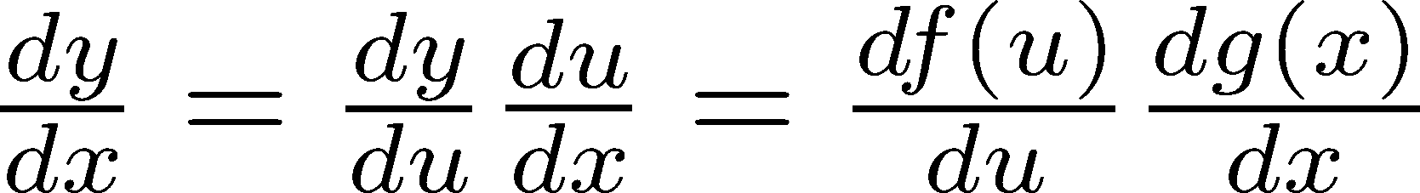
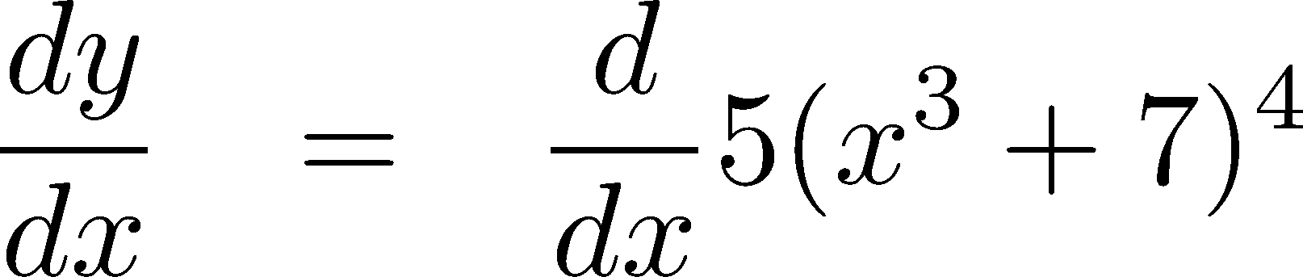
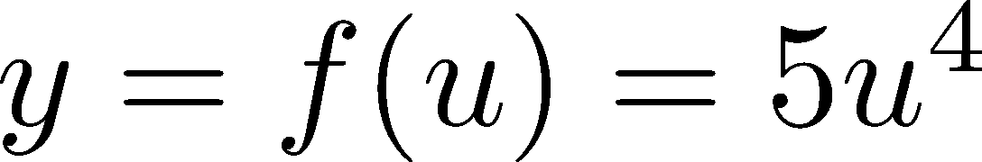
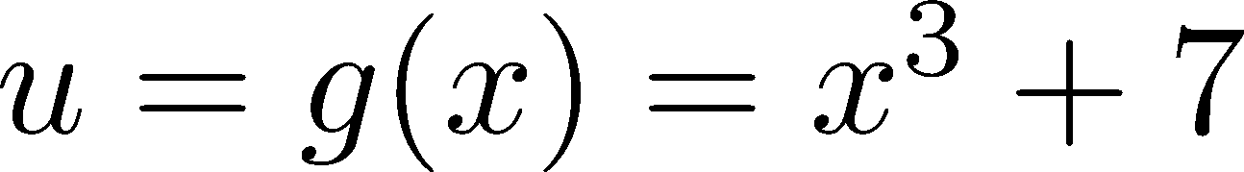
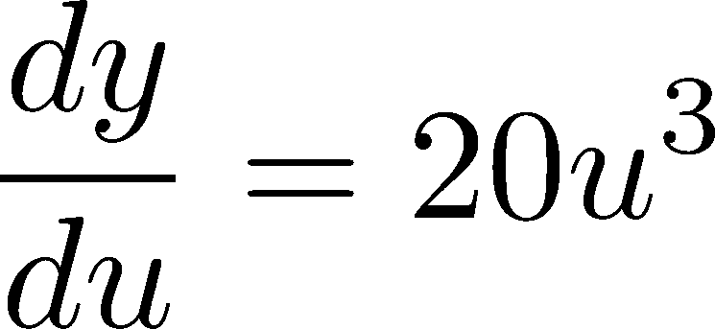
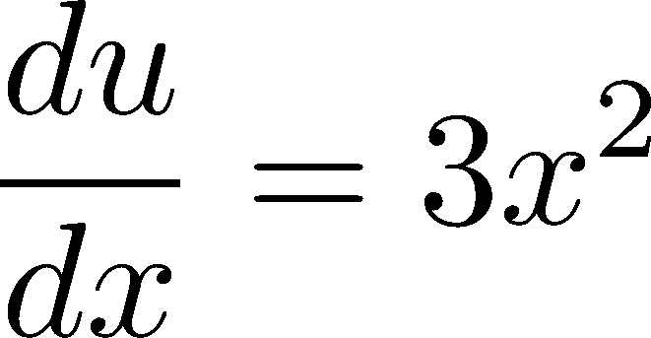
Chain Rule
Chain rule! If y = f(u) and u = g(x), i.e. y = f(g(x)), then:
Simple example:
^{𝑑𝑦} = 20(𝑥| + 7)|. 3𝑥⁼
𝑑𝑥

Slide 23
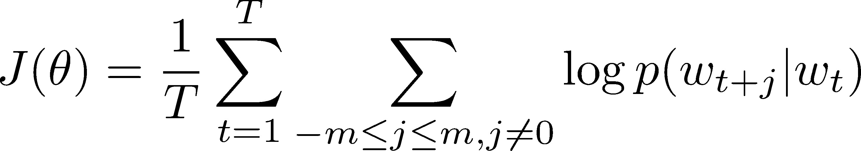
Interactive Whiteboard Session!
Let’s derive gradient for center word together
For one example window and one example outside word:
exp(𝑢_{Y}^{I}𝑣_{Z} )
log 𝑝 𝑜 𝑐 = log ∑]
exp(𝑢_{U}^{I}𝑣_{Z} )
UH<
You then also need the gradient for context words (it’s similar; left for homework). That’s all of the parameters 𝜃 here.

Slide 24
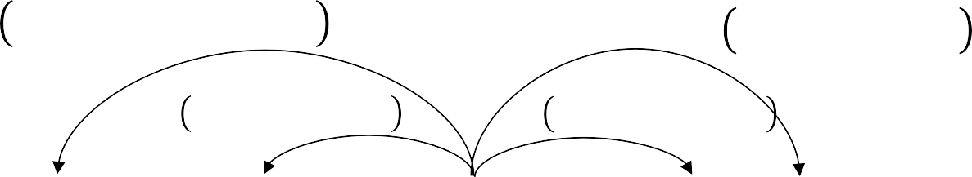
Calculating all gradients!
We went through gradient for each center vector v in a window
We also need gradients for outside vectors u
Derive at home!
Generally in each window we will compute updates for all parameters that are being used in that window. For example:
^{𝑃 𝑢}8s_eder ^{|𝑣}`peqder
^{𝑃 𝑢}pc ^{|𝑣}`peqder
^{𝑃 𝑢}Z_dcbc ^{|𝑣}`peqder
^{𝑃 𝑢}de8Y ^{| 𝑣}`peqder
…
problems
turning
into
banking
crises
as
…
outside context words center word outside context words in window of size 2 at position t in window of size 2

Slide 25
Word2vec: More details
Why two vectors? → Easier optimization. Average both at the end.
Two model variants:
Skip-grams (SG)
Predict context (”outside”) words (position independent) given center word
Continuous Bag of Words (CBOW)
Predict center word from (bag of) context words
Additional efficiency in training:
1. Negative sampling

Slide 26

1. Review: Main idea of word2vec
Start with random word vectors
Iterate through each word in the whole corpus
Try to predict surrounding words using word vectors
𝑃 𝑤_{5:9} | 𝑤₅ 𝑃 𝑤₅₆₉ | 𝑤₅
𝑃 𝑤_{5:7} | 𝑤₅ 𝑃 𝑤₅₆₇ | 𝑤₅
…
problems
turning
into
banking
crises
as
…
&'((*,- )
Update vectors so you can predict better
𝑃 𝑜 𝑐 =
+ .
∑ &'((*, -.)
1∈3
1
This algorithm learns word vectors that capture word similarity and meaningful directions in a wordspace
3

Slide 27
Word2vec parameters and computations
• • • • •
• • • ••
• • • ••
• • • ••
• • • ••
• • • ••
U
• • • • •
• • • ••
• • • ••
• • • ••
• • • ••
• • • ••
V
•
•
•
•
•
•
•
•
•
•
•
•
𝑈. 𝑣>?
dot product
softmax(𝑈. 𝑣>?) probabilities
outside
center
!
Same predictions at each position
We want a model that gives a reasonably high probability estimate to all words that occur in the context (fairly often)

Slide 28
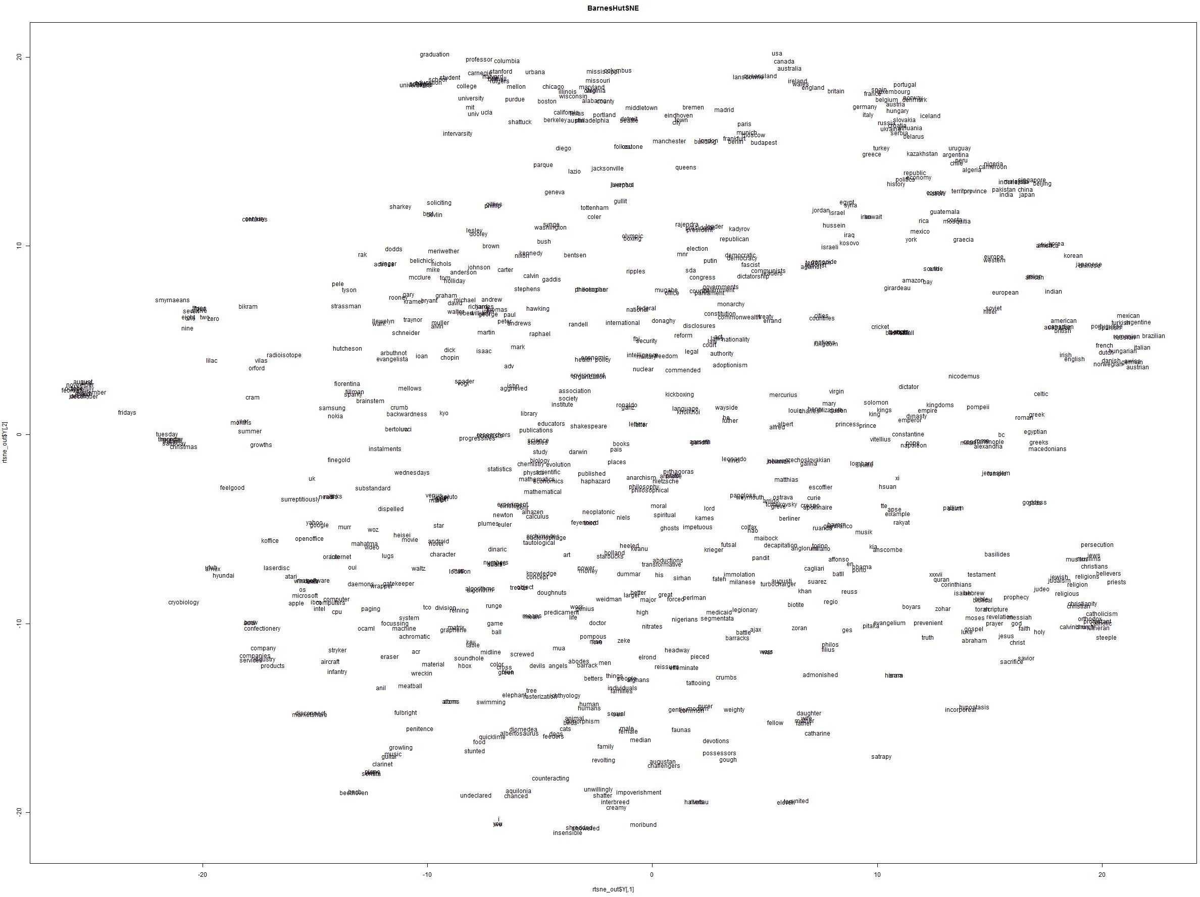
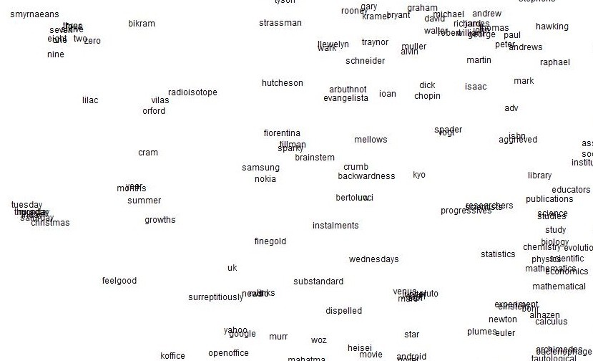
Word2vec maximizes objective function by putting similar words nearby in space

Slide 29
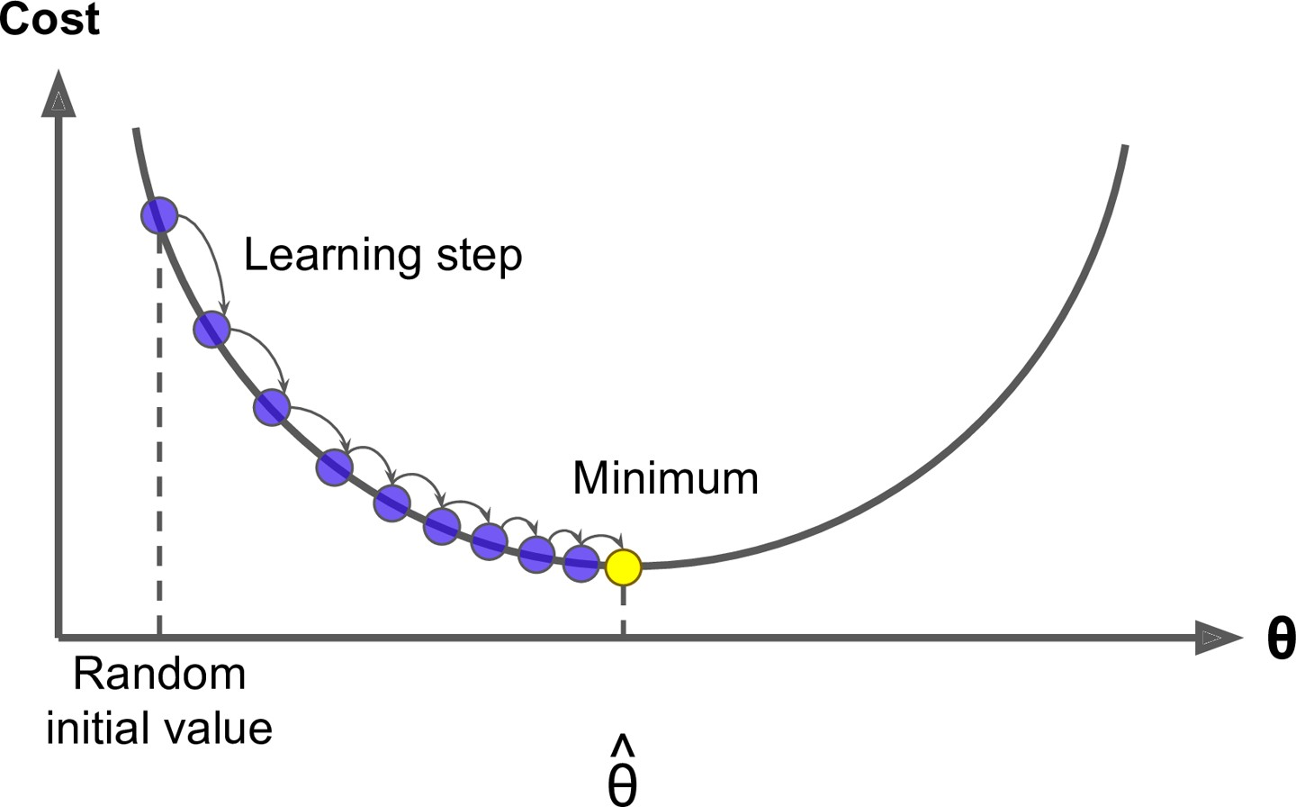

2. Optimization: Gradient Descent
We have a cost function 𝐽 𝜃 we want to minimize
Gradient Descent is an algorithm to minimize 𝐽 𝜃
Idea: for current value of 𝜃, calculate gradient of 𝐽 𝜃 , then take
small step in the direction of negative gradient. Repeat.
Note: Our objectives may not be convex like this

Slide 30
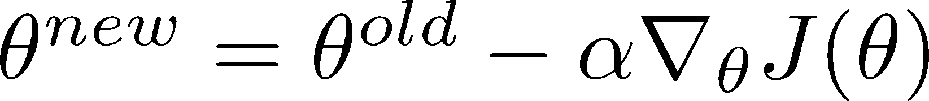
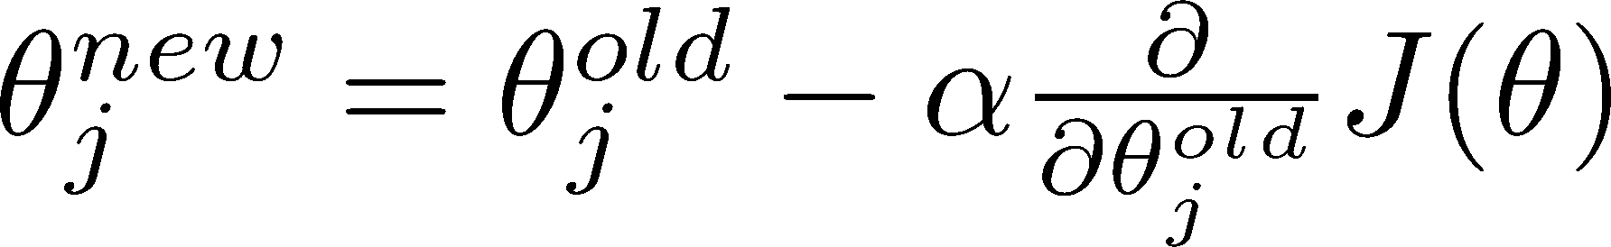
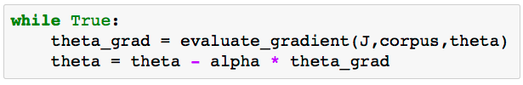
Gradient Descent
Update equation (in matrix notation):
𝛼 = step size or learning rate
Update equation (for a single parameter):
Algorithm:

Slide 31
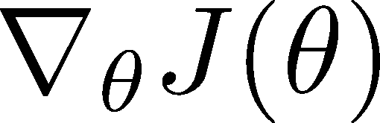
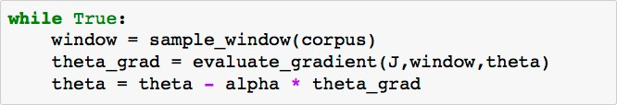
Stochastic Gradient Descent
Problem: 𝐽 𝜃 is a function of all windows in the corpus (potentially billions!)
So is very expensive to compute
You would wait a very long time before making a single update!
Very bad idea for pretty much all neural nets!
Solution: Stochastic gradient descent (SGD)
Repeatedly sample windows, and update after each one
Algorithm:

Slide 32
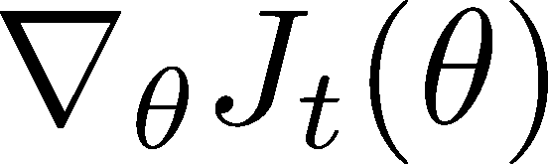
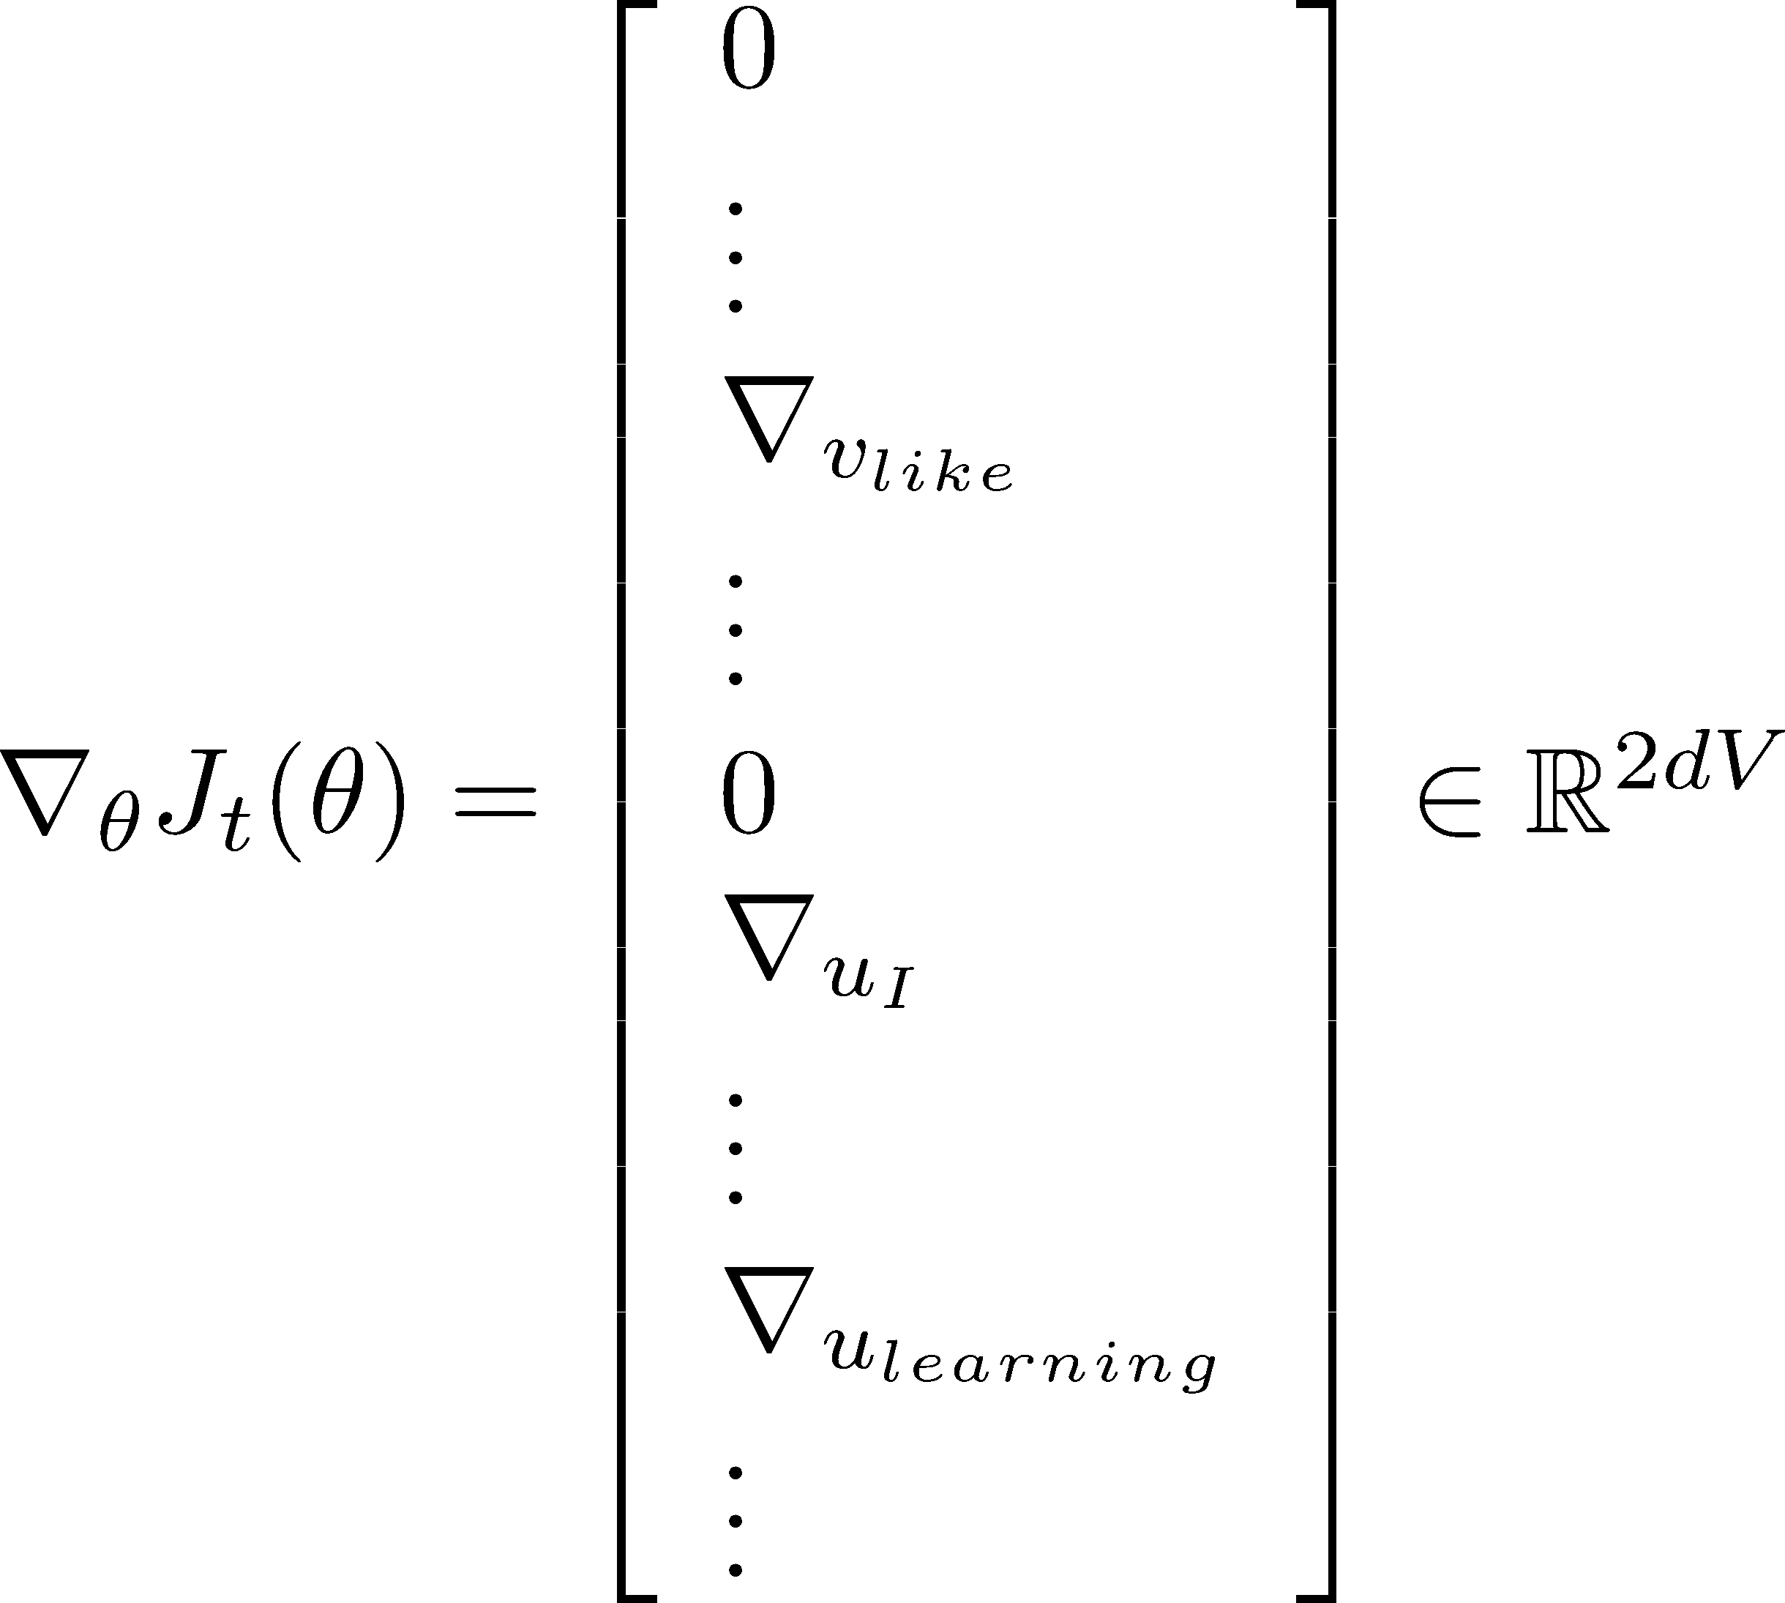
Stochastic gradients with word vectors!
Iteratively take gradients at each such window for SGD
But in each window, we only have at most 2m + 1 words, so is very sparse!

Slide 33




Stochastic gradients with word vectors!
We might only update the word vectors that actually appear!
Solution: either you need sparse matrix update operations to only update certain rows of full embedding matrices U and V, or you need to keep around a hash for word vectors
[ ]
d
|V|
If you have millions of word vectors and do distributed computing, it is important to not have to send gigantic updates around!

Slide 34
1b. Word2vec: More details
Why two vectors? → Easier optimization. Average both at the end
But can do algorithm with just one vector per word Two model variants:
Skip-grams (SG)
Predict context (“outside”) words (position independent) given center word
Continuous Bag of Words (CBOW)
Predict center word from (bag of) context words We presented: Skip-gram model
Additional efficiency in training:
1. Negative sampling
So far: Focus on naïve softmax (simpler, but expensive, training method)

Slide 35
The skip-gram model with negative sampling (HW2)
The normalization factor is too computationally expensive.
&'((*,- )
𝑃 𝑜 𝑐 =
+ .
∑ &'((*, -.)
1∈3
1
Hence, in standard word2vec and HW2 you implement the skip- gram model with negative sampling
Main idea: train binary logistic regressions for a true pair (center word and word in its context window) versus several noise pairs (the center word paired with a random word)

Slide 36
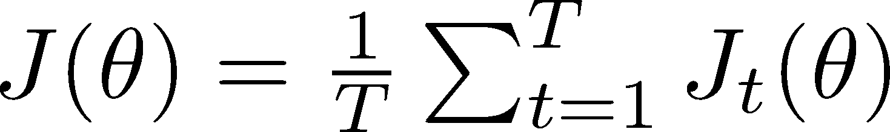
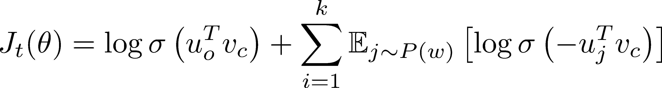
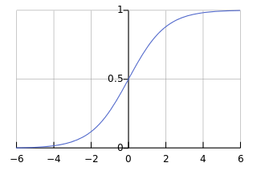
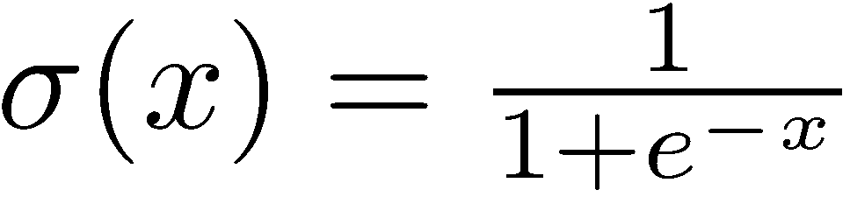
The skip-gram model with negative sampling (HW2)
From paper: “Distributed Representations of Words and Phrases and their Compositionality” (Mikolov et al. 2013)
Overall objective function (they maximize):
The sigmoid function:
(we’ll become good friends soon)
So we maximize the probability
of two words co-occurring in first log
→

Slide 37
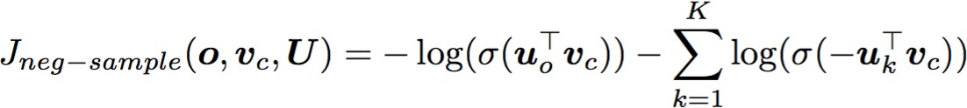
The skip-gram model with negative sampling (HW2)
Notation more similar to class and HW2:
We take k negative samples (using word probabilities)
Maximize probability that real outside word appears,
minimize prob. that random words appear around center word
P(w)=U(w)^{3/4}/Z,
the unigram distribution U(w) raised to the 3/4 power (We provide this function in the starter code).
The power makes less frequent words be sampled more often

Slide 38
3. Why not capture co-occurrence counts directly?
With a co-occurrence matrix X
2 options: windows vs. full document
Window: Similar to word2vec, use window around each word → captures both syntactic (POS) and semantic information
Word-document co-occurrence matrix will give general topics (all sports terms will have similar entries) leading to “Latent Semantic Analysis”
38

Slide 39
Example: Window based co-occurrence matrix
Window length 1 (more common: 5–10)
Symmetric (irrelevant whether left or right context)
Example corpus:
I like deep learning.
I like NLP.
I enjoy flying.
39

Slide 40
Window based co-occurrence matrix
Example corpus:
I like deep learning.
I like NLP.
I enjoy flying.
counts | I | like | enjoy | deep | learning | NLP | flying | .
I | 0 | 2 | 1 | 0 | 0 | 0 | 0 | 0
like | 2 | 0 | 0 | 1 | 0 | 1 | 0 | 0
enjoy | 1 | 0 | 0 | 0 | 0 | 0 | 1 | 0
deep | 0 | 1 | 0 | 0 | 1 | 0 | 0 | 0
learning | 0 | 0 | 0 | 1 | 0 | 0 | 0 | 1
NLP | 0 | 1 | 0 | 0 | 0 | 0 | 0 | 1
flying | 0 | 0 | 1 | 0 | 0 | 0 | 0 | 1
. | 0 | 0 | 0 | 0 | 1 | 1 | 1 | 0
40

Slide 41
Problems with simple co-occurrence vectors
Increase in size with vocabulary
Very high dimensional: requires a lot of storage Subsequent classification models have sparsity issues
→ Models are less robust
41

Slide 42
Solution: Low dimensional vectors
Idea: store “most” of the important information in a fixed, small number of dimensions: a dense vector
Usually 25–1000 dimensions, similar to word2vec
How to reduce the dimensionality?
19

Slide 43
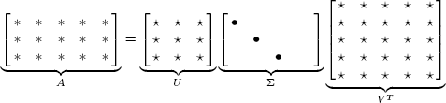
Method: Dimensionality Reduction on X (HW1)
Singular Value Decomposition of co-occurrence matrix X
Factorizes X into UΣV^{T}, where U and V are orthonormal
_{X} k
Retain only k singular values, in order to generalize.
𝑋^{J} is the best rank k approximation to X , in terms of least squares. Classic linear algebra result. Expensive to compute for large matrices.
20

Slide 44
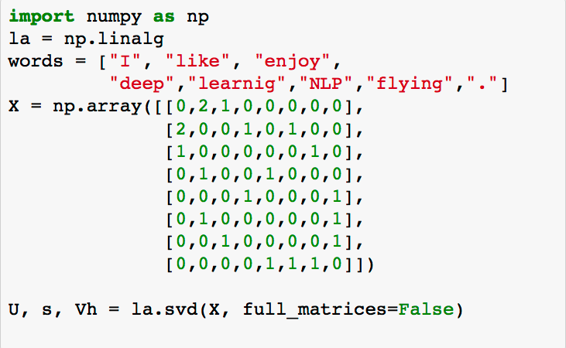
Simple SVD word vectors in Python
Corpus:
I like deep learning. I like NLP. I enjoy flying.
44

Slide 45
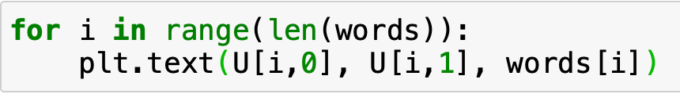
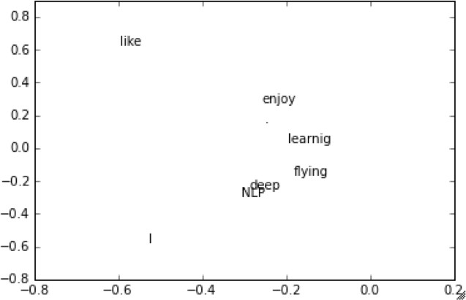
Simple SVD word vectors in Python
Corpus: I like deep learning. I like NLP. I enjoy flying.
Printing first two columns of U corresponding to the 2 biggest singular values
45

Slide 46
Hacks to X (several used in Rohde et al. 2005)
Scaling the counts in the cells can help a lot
Problem: function words (the, he, has) are too frequent → syntax has too much impact. Some fixes:
min(X,t), with t ≈ 100
Ignore them all
Ramped windows that count closer words more
Use Pearson correlations instead of counts, then set negative values to 0
Etc.
46

Slide 47
Interesting syntactic patterns emerge in the vectors
CHOOSING
CHOOSE CHOSCEHNOSE
STOLEN STEAL
STOLE
STEALING
SPOKE
SPEAK
TAKE
SPOKEN
TAKEN
SPEAKING
TAKING TOOK
THROW^{T}N^{HR}T^{O}H^{W}REW
THROWING
SHOWN
SHOWED SHOWING
EATEN_{T}
ATE
EATING
SHOW
GROWN
GROW
GREW
GROWING
COALS model from
An Improved Model of Semantic Similarity Based on Lexical Co-Occurrence Rohde et al. ms., 2005
47

Slide 48
Interesting semantic patterns emerge in the vectors
DRIVER
JANITOR STUDENT
DRIVE
SWIMMER
CLEAN
TEACHER
DOCTOR
BRIDE
SWIM
PRIEST
LEARN
TEACH
MARRY
TREAT
PRAY
COALS model from
An Improved Model of Semantic Similarity Based on Lexical Co-Occurrence Rohde et al. ms., 2005
48

Slide 49


4. Towards GloVe: Count based vs. direct prediction
LSA, HAL (Lund & Burgess),
COALS, Hellinger-PCA (Rohde et al, Lebret & Collobert)
Fast training
Efficient usage of statistics
Primarily used to capture word similarity
Disproportionate importance given to large counts
Skip-gram/CBOW (Mikolov et al)
NNLM, HLBL, RNN (Bengio et
al; Collobert & Weston; Huang et al; Mnih & Hinton)
Scales with corpus size
Inefficient usage of statistics
Generate improved performance on other tasks
Can capture complex patterns beyond word similarity
26

Slide 50

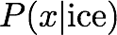
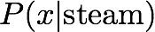
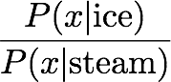
Encoding meaning in vector differences
[Pennington, Socher, and Manning, EMNLP 2014]
Crucial insight:
Ratios of co-occurrence probabilities can encode meaning components
 |  | x = solid | x = gas | x = water | x = random
 |  | large | small | large | small
 |  | small | large | large | small
 |  | large | small | ~1 | ~1

Slide 51
Encoding meaning in vector differences
[Pennington, Socher, and Manning, EMNLP 2014]
Crucial insight:
Ratios of co-occurrence probabilities can encode meaning components
 |  | x = solid | x = gas | x = water | x = fashion
 |  | 1.9 x 10⁻⁴ | 6.6 x 10⁻⁵ | 3.0 x 10⁻³ | 1.7 x 10⁻⁵
 |  | 2.2 x 10⁻⁵ | 7.8 x 10⁻⁴ | 2.2 x 10⁻³ | 1.8 x 10⁻⁵
 |  | 8.9 | 8.5 x 10⁻² | 1.36 | 0.96

Slide 52
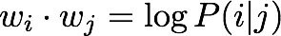
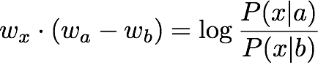
Encoding meaning in vector differences
Q: How can we capture ratios of co-occurrence probabilities as linear meaning components in a word vector space?
A: Log-bilinear model:
with vector differences

Slide 53
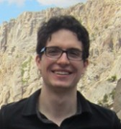







Combining the best of both worlds GloVe [Pennington et al., EMNLP 2014]
Fast training
Scalable to huge corpora
Good performance even with small corpus and small vectors

Slide 54




GloVe results
Nearest words to frog:
frogs
toad
litoria
leptodactylidae
rana
lizard
eleutherodactylus
litoria
leptodactylidae
rana
eleutherodactylus
31

Slide 55
5. How to evaluate word vectors?
Related to general evaluation in NLP: Intrinsic vs. extrinsic
Intrinsic:
Evaluation on a specific/intermediate subtask
Fast to compute
Helps to understand that system
Not clear if really helpful unless correlation to real task is established
Extrinsic:
Evaluation on a real task
Can take a long time to compute accuracy
Unclear if the subsystem is the problem or its interaction or other subsystems
If replacing exactly one subsystem with another improves accuracy →
Winning!

Slide 56





Intrinsic word vector evaluation
Word Vector Analogies
a:b :: c:?
man:woman :: king:?
Evaluate word vectors by how well their cosine distance after addition captures intuitive semantic and syntactic analogy questions
Discarding the input words from the search!
Problem: What if the information is there but not linear?
king
woman
man

Slide 57

Glove Visualizations
57

Slide 58

Glove Visualizations: Company - CEO
58

Slide 59

Glove Visualizations: Superlatives
59

Slide 60
Analogy evaluation and hyperparameters
Glove word vectors evaluation
Model | Dim. | Size | Sem. | Syn. | Tot.
SVD | 300 | 6B | 6.3 | 8.1 | 7.3
SVD-S | 300 | 6B | 36.7 | 46.6 | 42.1
SVD-L | 300 | 6B | 56.6 | 63.0 | 60.1
CBOW† | 300 | 6B | 63.6 | 67.4 | 65.7
SG† | 300 | 6B | 73.0 | 66.0 | 69.1
GloVe | 300 | 6B | 77.4 | 67.0 | 71.7
37

Slide 61












Analogy evaluation and hyperparameters
More data helps
Wikipedia is better than news text!
Dimensionality
Good dimension is ~300
Semantic
Syntactic
Overall
80
85
70
80
Accuracy [%]
75
Accuracy [%]
60
70
65
50
60
40
Semantic Syntactic Overall
55
30
50
Wiki2010 1B tokens
Wiki2014 1.6B tokens
Gigaword5 4.3B tokens
Gigaword5 + Wiki2014 6B tokens
Common Crawl 42B tokens
20
0
100
200 300 400 500
Vector Dimension
600
38

Slide 62
Another intrinsic word vector evaluation
Word vector distances and their correlation with human judgments
Example dataset: WordSim353 http://www.cs.technion.ac.il/~gabr/resources/data/wordsim353/
Word 1 | Word 2 | Human (mean)
tiger | cat | 7.35
tiger | tiger | 10
book | paper | 7.46
computer | internet | 7.58
plane | car | 5.77
professor | doctor | 6.62
stock | phone | 1.62
stock | CD | 1.31
stock | jaguar | 0.92

Slide 63
Correlation evaluation
Word vector distances and their correlation with human judgments
Model | Size | WS353 | MC | RG | SCWS | RW
SVD | 6B | 35.3 | 35.1 | 42.5 | 38.3 | 25.6
SVD-S | 6B | 56.5 | 71.5 | 71.0 | 53.6 | 34.7
SVD-L | 6B | 65.7 | 72.7 | 75.1 | 56.5 | 37.0
CBOW† | 6B | 57.2 | 65.6 | 68.2 | 57.0 | 32.5
SG† | 6B | 62.8 | 65.2 | 69.7 | 58.1 | 37.2
GloVe | 6B | 65.8 | 72.7 | 77.8 | 53.9 | 38.1
SVD-L | 42B | 74.0 | 76.4 | 74.1 | 58.3 | 39.9
GloVe | 42B | 75.9 | 83.6 | 82.9 | 59.6 | 47.8
CBOW⇤ | 100B | 68.4 | 79.6 | 75.4 | 59.4 | 45.5
Some ideas from Glove paper have been shown to improve skip-gram (SG) model also (e.g. sum both vectors)

Slide 64
Extrinsic word vector evaluation
Extrinsic evaluation of word vectors: All subsequent tasks in this class
One example where good word vectors should help directly: named entity recognition: finding a person, organization or location
Model | Dev | Test | ACE | MUC7
Discrete | 91.0 | 85.4 | 77.4 | 73.4
SVD | 90.8 | 85.7 | 77.3 | 73.7
SVD-S | 91.0 | 85.5 | 77.6 | 74.3
SVD-L | 90.5 | 84.8 | 73.6 | 71.5
HPCA | 92.6 | 88.7 | 81.7 | 80.7
HSMN | 90.5 | 85.7 | 78.7 | 74.7
CW | 92.2 | 87.4 | 81.7 | 80.2
CBOW | 93.1 | 88.2 | 82.2 | 81.1
GloVe | 93.2 | 88.3 | 82.9 | 82.2
Next: How to use word vectors in neural net models!

Slide 65
6. Word senses and word sense ambiguity
Most words have lots of meanings!
Especially common words
Especially words that have existed for a long time
Example: pike
Does one vector capture all these meanings or do we have a mess?

Slide 66
pike
A sharp point or staff
A type of elongated fish
A railroad line or system
A type of road
The future (coming down the pike)
A type of body position (as in diving)
To kill or pierce with a pike
To make one’s way (pike along)
In Australian English, pike means to pull out from doing something: I reckon he could have climbed that cliff, but he piked!

Slide 67

Improving Word Representations Via Global Context And Multiple Word Prototypes (Huang et al. 2012)
Idea: Cluster word windows around words, retrain with each word assigned to multiple different clusters bank₁, bank₂, etc

Slide 68

Linear Algebraic Structure of Word Senses, with
Applications to Polysemy
(Arora, …, Ma, …, TACL 2018)
Different senses of a word reside in a linear superposition (weighted sum) in standard word embeddings like word2vec
•
^{𝑣}pike ^{= 𝛼7𝑣}pike_{P} ^{+ 𝛼9𝑣}pike_{R} ^{+ 𝛼S𝑣}pike_{T}
Where 𝛼₇ =
U_{P}
, etc., for frequency f
U_{P}6U_{R}6U_{T}
Surprising result:
Because of ideas from sparse coding you can actually separate out the senses (providing they are relatively common)

Slide 69
7. Classification review and notation
Generally we have a training dataset consisting of samples
{x_{i},y_{i}}^{N}_{i=1}
x_{i} are inputs, e.g. words (indices or vectors!), sentences, documents, etc.
Dimension d
y_{i} are labels (one of C classes) we try to predict, for example:
classes: sentiment, named entities, buy/sell decision
other words
later: multi-word sequences

Slide 70


Classification intuition
Training data: {x_{i},y_{i}}^{N}_{i=1}
Simple illustration case:
Fixed 2D word vectors to classify
Using softmax/logistic regression
Linear decision boundary
Visualizations with ConvNetJS by Karpathy!
http://cs.stanford.edu/people/karpathy/convnetjs/demo/classify2d.html
Traditional ML/Stats approach: assume x_{i} are fixed,
train (i.e., set) softmax/logistic regression weights 𝑊 ∈ ℝ^{X×Z}
to determine a decision boundary (hyperplane) as in the picture
Method: For each fixed x, predict:

Slide 71


Details of the softmax classifier
We can tease apart the prediction function into three steps:
1. Take the y^{th} row of W and multiply that row with x:
Compute all f_{c} for c = 1, …, C
Apply softmax function to get normalized probability:
= softmax(𝑓\)
Choose the y with maximum probability

Slide 72

Training with softmax and cross-entropy loss
For each training example (x,y), our objective is to maximize the probability of the correct class y
Or we can minimize the negative log probability of that class:

Slide 73

Background: What is “cross entropy” loss/error?
Concept of “cross entropy” is from information theory
Let the true probability distribution be p
Let our computed model probability be q
The cross entropy is:
Assuming a ground truth (or true or gold or target) probability distribution that is 1 at the right class and 0 everywhere else: p = [0,…,0,1,0,…0] then:
Because of one-hot p, the only term left is the negative log probability of the true class

Slide 74



Classification over a full dataset
Cross entropy loss function over
full dataset {x ,y }^{N}
i i i=1
Instead of
We will write f in matrix notation:

Slide 75


Traditional ML optimization
For general machine learning 𝜃 usually only consists of columns of W:
So we only update the decision boundary via
Visualizations with ConvNetJS by Karpathy

Slide 76

Neural Network Classifiers
Softmax (≈ logistic regression) alone not very powerful
Softmax gives only linear decision boundaries
This can be quite limiting
→ Unhelpful when a problem is complex
Wouldn’t it be cool to get these correct?
•
•
76

Slide 77

Neural Nets for the Win!
Neural networks can learn much more complex functions and nonlinear decision boundaries!
In the original space
77

Slide 78

Classification difference with word vectors
Commonly in NLP deep learning:
We learn both W and word vectors x
We learn both conventional parameters and representations
The word vectors re-represent one-hot vectors—move them around in an intermediate layer vector space—for easy classification with a (linear) softmax classifier via layer x = Le
Very large number of parameters!
55

Slide 79


8. The course
A note on your experience 😀
“Terrible class” “Don’t take it” “Too much work”
“Best class at Stanford” “Changed my life”
“Obvious that instructors care” “Learned a ton”
“Hard but worth it”
This is a hard, advanced, graduate level class
I and all the TAs really care about your success in this class
Give Feedback. Take responsibility for holes in your knowledge
Come to office hours/help sessions
56

Slide 80
Office Hours / Help sessions
Come to office hours/help sessions!
Come to discuss final project ideas as well as the assignments
Try to come early, often and off-cycle
Help sessions: daily, at various times, see calendar
Attending in person: Just show up! Our friendly course staff will be on hand to assist you
SCPD/remote access: Use queuestatus
Chris’s office hours:
Mon 4–6pm. Come along next Monday?
57

